Slide 1


Slide 2
The Introduction
Chapter 5

Slide 3
Introduction
Next step is to design or plan the study
Proposal introduction has five components:
  Establishing the problem leading to the study
  Reviewing the literature about the problem
  Identifying deficiencies in the literature about the problem
  Targeting an audience and noting the significance
  Identifying the purpose of the proposed study

Slide 4
The Importance of Introductions
The introduction is the initial passage in a study or proposal that
  Sets the stage for the project
  Creates reader interest in the topic
  Establishes the problem leads to the study
  Places the study within the larger literature
  Reaches out to a specific audience

Slide 5
The Importance of Introductions
A research problem is the problem or issue that leads to the need for a study
Sources
  Personal experience
  Debate in the literature
  Gaps that need to be addressed
  Policy debates

Slide 6
An Abstract for a Study
A brief summary of the contents of a study
Allows the reader to quickly survey the essential elements of the study
Components
  Issue or problem
  Purpose of the study
  What data that will be collected
  Themes, statistical results, or mixed methods integrated findings that are likely
  Practical implications of the study

Slide 7
Qualitative, Quantitative, and Mixed Methods Introductions
Similar pattern for all approaches, but some differences
Qualitative introductions
  Problem calls for exploration
  May be shaped by a theoretical lens
  May be written from a personal, first-person, subjective point of view

Slide 8
Qualitative, Quantitative, and Mixed Methods Introductions
Quantitative introductions
  Problem calls for understanding what factors and variables influencing an outcome
  May advance a theory to test
  Incorporate substantial literature review
  May be written from an impersonal point of view

Slide 9
Qualitative, Quantitative, and Mixed Methods Introductions
Mixed methods introductions
  Can use a quantitative or qualitative approach or a combination
  If one approach is emphasized or begins the study, then the introduction may follow that approach
  May reflect need to understand relationships and explore
  Problem may include the need for other methodologies

Slide 10
A Model for an Introduction
Deficiencies model of an introduction builds on gaps in the literature
Write one paragraph per element (about 2 pages)
  State the research problem
  Review studies that have addressed the problem
  Indicate deficiencies in the studies
  Advance the significance of the study for particular audiences
  State the purpose statement

Slide 11
A Model for an Introduction
The research problem:
Pique interest
Convey distinct research problem or issue
Narrative hook draws, engages, or hooks the reader into the study

Slide 12
A Model for an Introduction
The research problem:
Begins with narrative hook
Easily understood by many readers
Builds readers’ interest through reference to study participants or posing questions
Clearly identify the issue(s) or problem(s) that lead to a need for the study
Indicate why the problem is important by citing numerous references

Slide 13
A Model for an Introduction
The research problem – Tips for opening paragraph:
Opening sentence should stimulate interest while conveying the issue
Do not use quotations to avoid confusion
Avoid idiomatic expressions
Consider numeric information for impact
Clearly identify the research problem

Slide 14
A Model for an Introduction
The research problem – Tips for opening paragraph:
Indicate why the problem is important using the existing literature
Frames the problem in a manner consistent with the research approach
Consider whether there is a single problem or multiple problems addressed

Slide 15
A Model for an Introduction
Studies addressing the problem:
Not a complete literature review as in the full literature review (Chapter 2)
The literature review in the introduction serves to
  Justify the importance of the problem
  Create distinctions between past studies and the proposed study
  Set the research problem within ongoing dialogue in the literature

Slide 16
A Model for an Introduction
Tips to consider when reviewing the literature for the introduction:
  Summarize groups of studies not individual ones
Use in-text referencing to remove the emphasis on any one study

Slide 17
A Model for an Introduction
Studies addressing the problem:
Review studies that use quantitative, qualitative, and mixed methods approaches
Use recent studies (last 10 years) and older studies that are of value

Slide 18
A Model for an Introduction
Deficiencies in past literature:
After advancing the problem and reviewing the literature, identify the deficiencies
Deficiencies in past literature may exist because:
  The topic has not been explored with a particular group, sample, or population
  The literature needs to be replicated with new people or sites
  The voice of underrepresented groups has not been heard in published literature

Slide 19
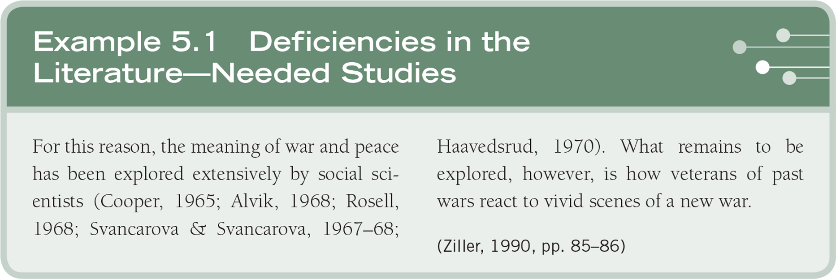
A Model for an Introduction

Slide 20

A Model for an Introduction

Slide 21
A Model for an Introduction
When identifying deficiencies in past literature:
Cite several deficiencies
Identify specifically the deficiencies of the other studies
Write about areas overlooked by past studies
Discuss how proposed study will
  Remedy or address the deficiencies
  Provide a unique contribution

Slide 22
A Model for an Introduction
Significance of a study for audiences:
Describe the significance of the study for select audiences
Consider including:
  3–4 reasons the study adds to the scholarly literature
  3–4 reasons the study helps to improve practice
  3–4 reasons the study will improve policy
End with a statement of the purpose of the study

Slide 23

A Model for an Introduction

Slide 24
Summary
The introduction incorporates the research problem
Five-part deficiencies model
  Research problem (narrative hook)
  Literature addressing problem
  Deficiencies in literature
  Audiences that will profit
  Purpose statement

